Slide 1


Tomasz Szymański
31-01-2022

Slide 2

Outline
Executive Summary
Introduction
Methodology
Results
Conclusion
Appendix

Slide 3
Executive Summary
Summary of methodologies
a) data collection:
- data scraping of the Space X launches of Wikipedia webpage,
- Space X public API,
b) Exploratory Data Analysis : SQL queries, Matplotlib and Seaborn graphs, an interactive Plotly dashboards and Folium maps
c) few various machine learning models (logistic regression, decision tree, KNN, SVN) to predict successful landings
Summary of all results
a) All models give similar results about 0,78
b) Seems that more data is required to improve accuracy as seems that results are overpredicted.

Slide 4
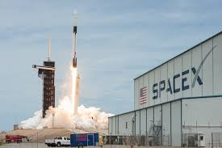
Introduction
Project background and context
Space exploration became more and more common,
Space X becomes the cheapest way to launch rackets to space, as the Space X reuse the Stage 1 (part) of rocket.
Space X launch costs 62 millions $ while others cost 165 millions $
Problem:
How to predict if launch will be completed successfully,
What machine learning models should be used,
What data are necessary to predict launch correctly

Slide 5

Section 1

Slide 6
Methodology
Executive Summary
Data collection methodology:
Data was got from Space X and wikipedia
Perform data wrangling
Pandas and NumPy ware used to clean and analyse data
Perform exploratory data analysis (EDA) using visualization and SQL
Perform interactive visual analytics using Folium and Plotly Dash
Perform predictive analysis using classification models
Scikit-Learn was used to create Machine Learning models and GridSearchCV for tuning

Slide 7
Data Collection
SpaceX API Calls:
- Space X has public API, where you can find information about launches coordinates, rocket, Payload mass, outcome of the mission etc.
- to obtain data from HTTP web page, get request was used.
Scraping SpaceX launch data Wikipedia page
- Wikipedia contains data from past SpaceX launches.
- to get these data, Beautiful Soup library was used.

Slide 8
Data Collection – SpaceX API
Get request to pull and parse Space X data
Data filtration - only Falcon 9 launches
Missing value replacment by average values
GitHub URL of SpaceX API calls notebook:
https://github.com/monas1975/IBM_data_science_spaceX_project/blob/main/Data_Collect_API.ipynb

Slide 9
Data Collection - Scraping
GitHub URL of SpaceX API calls notebook:
https://github.com/monas1975/IBM_data_science_spaceX_project/blob/main/Data_collection_with_Web_Scrapping.ipynb
Wiki web page - request Falcon 9 launches
column and variables extraction from HTML
Creating data frame

Slide 10
Data Wrangling
Calculate the number and occurrence of each orbit
Calculate the number and occurence of mission outcome per orbit type
Calculate the number of launches on each site
Create a landing outcome label from Outcome column
GitHub URL:
https://github.com/monas1975/IBM_data_science_spaceX_project/blob/main/Data_wrangling.ipynb

Slide 11
EDA with Data Visualization
Graph drawn:
- FlightNumber vs. PayloadMass (scatterplot),
- FlightNumber vs LaunchSite (scatterplot),
- Payload vs Launch Site (scatterplot),
- relationship between success rate and orbit type (barplot),
- FlightNumber and Orbit type (scatterplot),
- Payload and Orbit type (scatterplot),
- launch success yearly trend (lineplot)
GitHub URL: https://github.com/monas1975/IBM_data_science_spaceX_project/blob/main/EDA_with_Visualization_lab.ipynb

Slide 12
EDA with SQL
summarize the SQL queries performer:
- the names of the unique launch sites in the space mission,
- records (5) where launch sites begin with the string 'CCA’,
- total payload mass carried by boosters launched by NASA (CRS),
- average payload mass carried by booster version F9 v1.1,
- date when the first successful landing outcome in ground pad was achieved,
- the names of the boosters which have success in drone ship and have payload mass greater than 4000 but less than 6000,
- List the total number of successful and failure mission outcomes,
- List the names of the booster versions which have carried the maximum payload mass,
- List the failed landing outcomes in drone ship, their booster versions, and launch site names for in year 2015,
- Rank the count of landing outcomes (such as Failure (drone ship) or Success (ground pad)) between the date 2010-06-04 and 2017-03-20, in descending order
GitHub URL: https://github.com/monas1975/IBM_data_science_spaceX_project/blob/main/Exploratory_Analysis_with_SQL.ipynb

Slide 13
Build an Interactive Map with Folium
Elements added to map:
- circle and marker for each launch site, added as point of attention at map,
- marker cluster – easy way to show number of launches at each site,
- mouse position- to get coordinates,
- polly lines (lines between site and coastline)
GitHub:
https://github.com/monas1975/IBM_data_science_spaceX_project/blob/main/Interactive_Visual_Analytics_with_Folium_lab.ipynb

Slide 14
Build a Dashboard with Plotly Dash
The purpose of adding interactive dashboard was to give the users opportunity to decide which information would like to see.
Features add to dashboard:
- dropdown menu – to let select launch site and information related,
- interactable bar for payload mass,
- scatter plot that show correlation between payload mass and landing result,
- piechart – to show proportion between successful landing and unsuccessful.
GitHub URL:
https://github.com/monas1975/IBM_data_science_spaceX_project/blob/main/spacex_dash_app.py

Slide 15
Predictive Analysis (Classification)
Standarize the rest of values in columns and asign as X
Create array from Class column and asign it to Y
split data for train and test set
create models (logistic regression, decision tree, KNN,SVM) using GridSearchCV
Get the score of each model
For each model create confusion matrix
analyze scores and compare them by building bar chart
GitHub URL: https://github.com/monas1975/IBM_data_science_spaceX_project/blob/main/Machine_Learning_Prediction_lab.ipynb

Slide 16
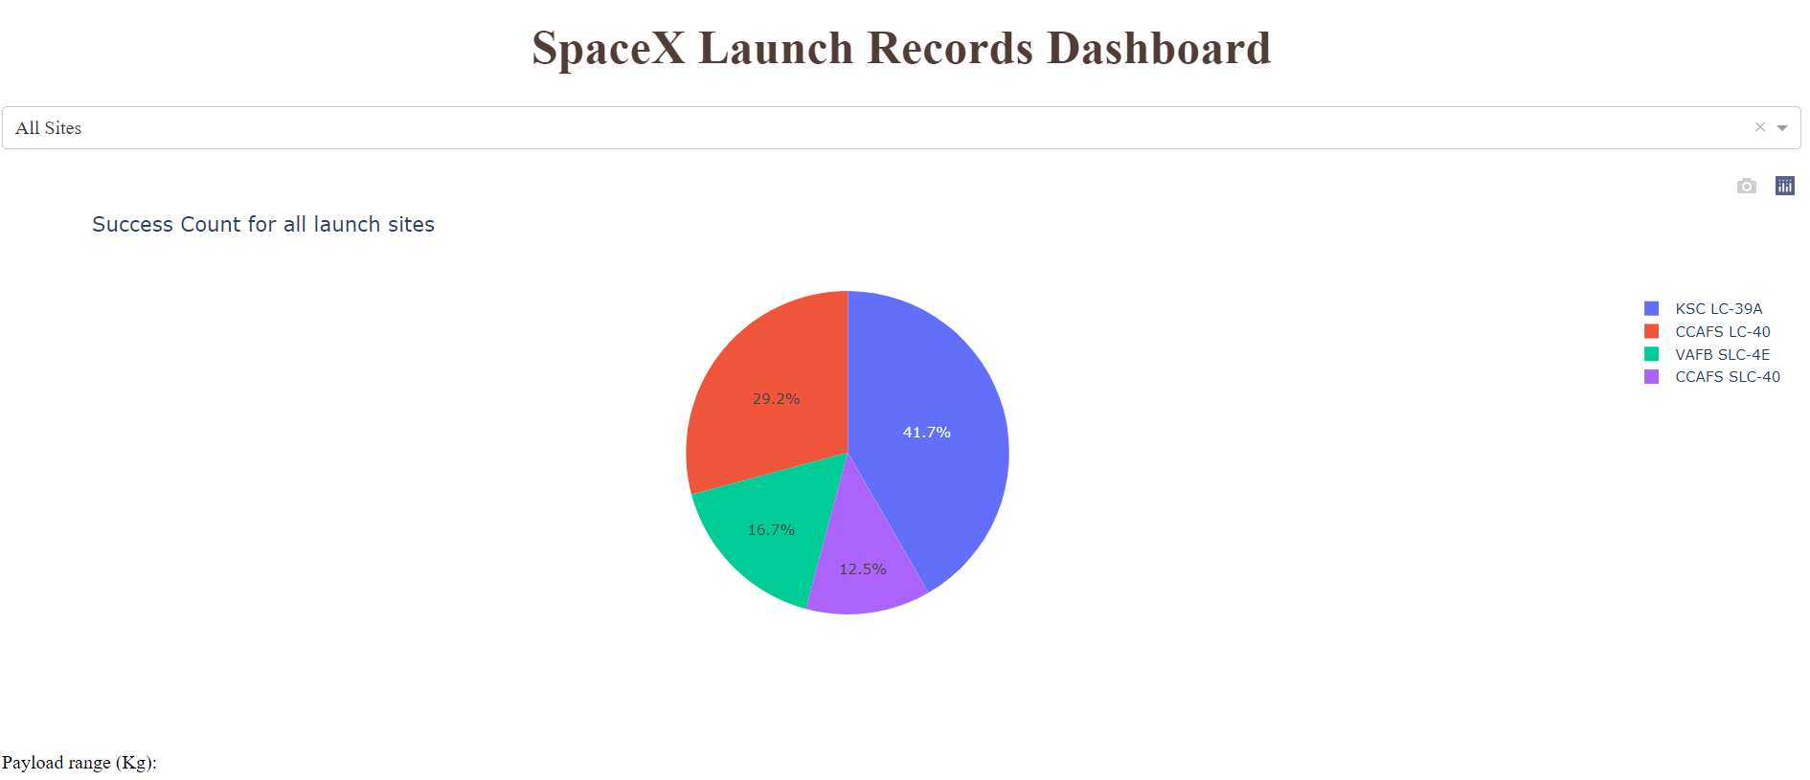
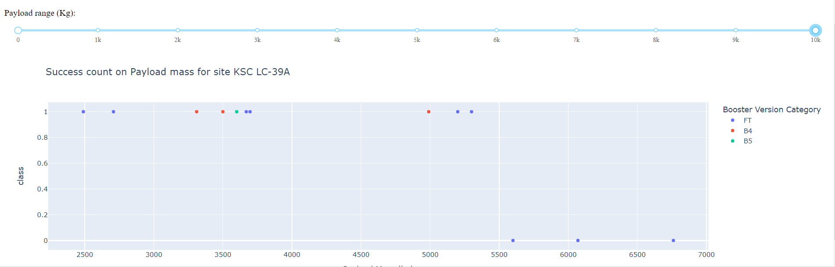
Interactive analytics demo in screenshots
Results from interactive dashboard depends on users' inputs,
Pie chart shows proportion between successful and unsuccessful landings for sites,
Scatter plot shows how payload mass impact on outcome of landings.

Slide 17
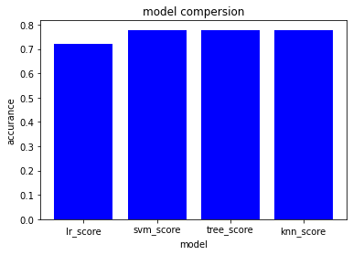
Predictive analysis results
Predictive analysis results : all models have similar accuracy 0.78, but logistic regression has the worst 0.72

Slide 18

Section 2

Slide 19
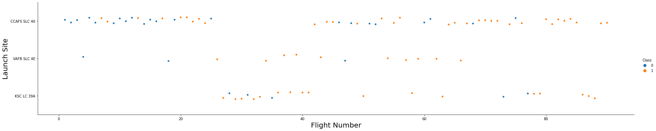
Flight Number vs. Launch Site
“CCAFS SLC 40” is the most often used platform. Amount of successful landing increase as flight numbers increases

Slide 20
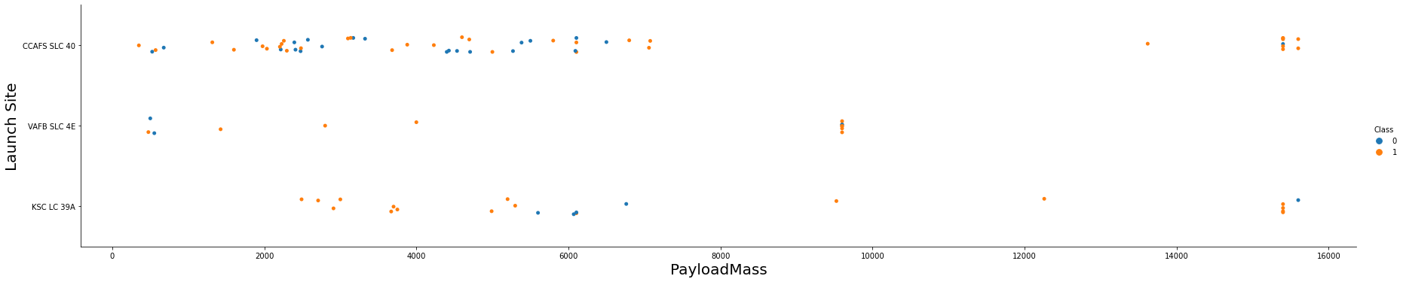
Payload vs. Launch Site
Most of the launches have payload below 7500kg
Most of the launches with payload over 8000 were successful

Slide 21
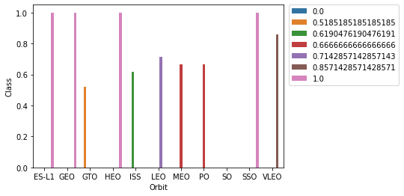
Success Rate vs. Orbit Type
There were any launch to SO orbit,
All other orbits have success rate over 50%
Orbits: ES-L1, GEO,HEO,SSO are the orbit with success rate =100%
GTO is the orbit with the lower success rate

Slide 22
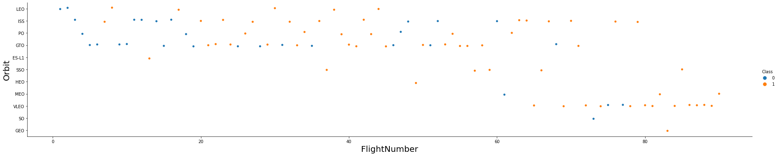
Flight Number vs. Orbit Type
There was an orbit type changes with flight number increase

Slide 23
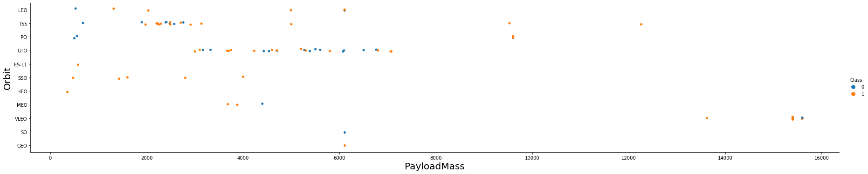
Payload vs. Orbit Type
There is the correlation between the payload and orbit chosen.
The launches with very high payload mass was to VLEO orbit

Slide 24
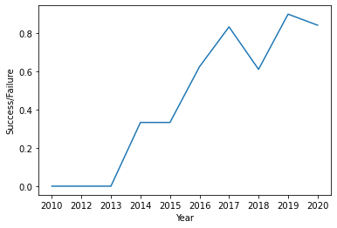
Launch Success Yearly Trend
Success rate increase year by year
Launches between 2010 and 2013 completed unsuccessfully
The maximum of success rate was in 2019
In 2018 the success rate drop down to 0.6

Slide 25
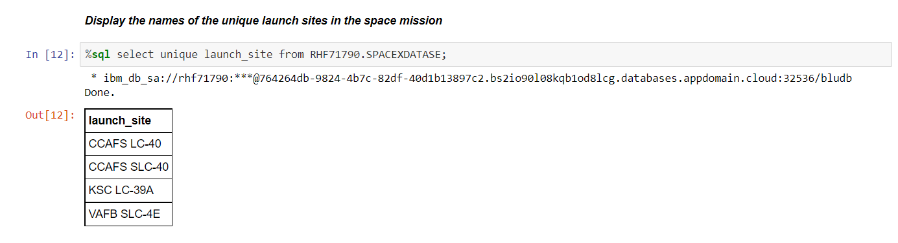
All Launch Site Names
In dataset there are 4 unique launch sites names

Slide 26
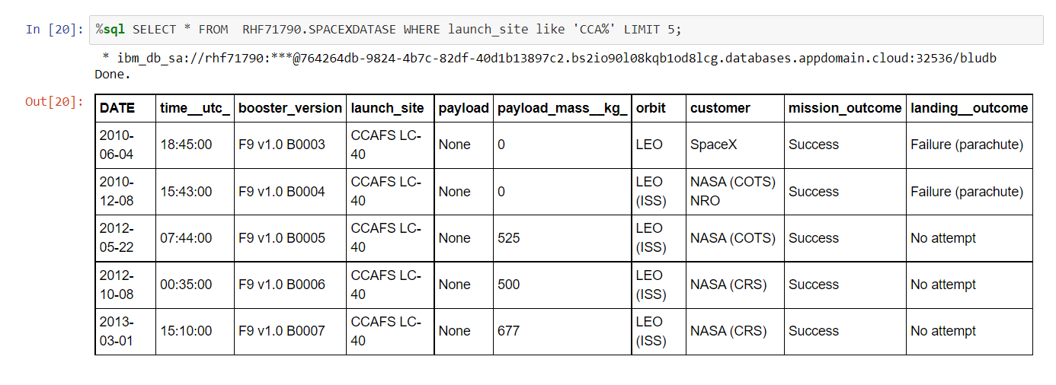
Launch Site Names Begin with 'CCA'
5 records where launch sites begin with `CCA`

Slide 27
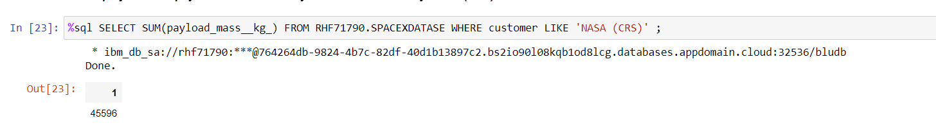
Total Payload Mass
The total payload carried by boosters from NASA is 45596 kg

Slide 28
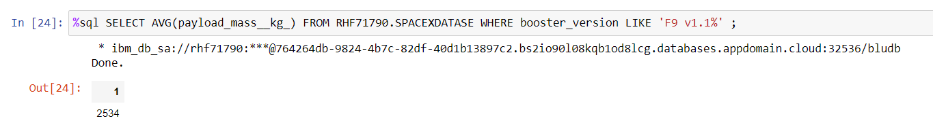
Average Payload Mass by F9 v1.1
The average payload mass carried by booster version F9 v1.1 is 2534 kg

Slide 29
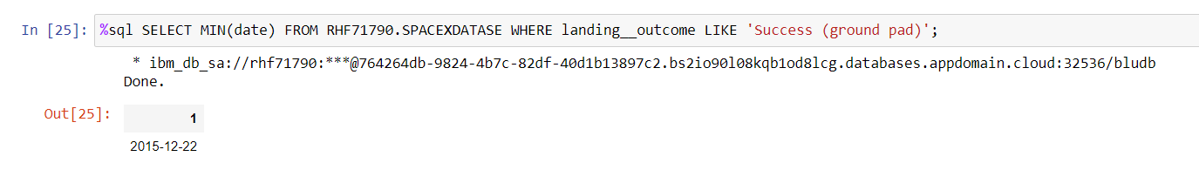
First Successful Ground Landing Date
The first successful landing outcome on ground pad was on 22nd of December 2015

Slide 30
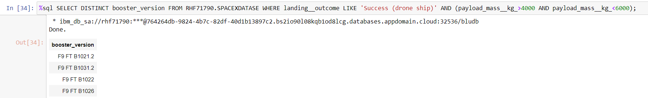
Successful Drone Ship Landing with Payload between 4000 and 6000
There are four boosters version with payload mass between 4000 and 6000 kg that have successfully landed on drone ship

Slide 31
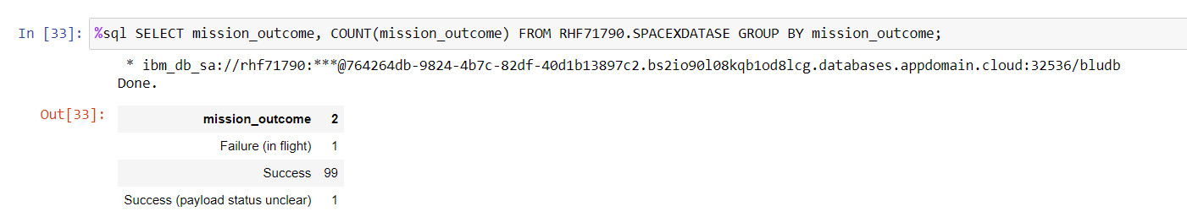
Total Number of Successful and Failure Mission Outcomes
There were 99 successful mission and only 1 failure.

Slide 32
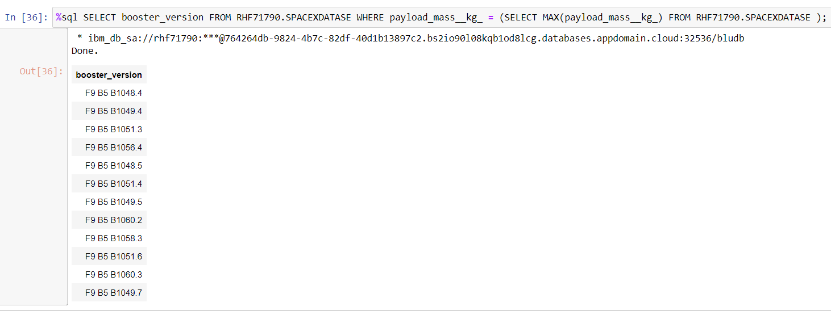
Boosters Carried Maximum Payload
List the names of the booster versions which have carried the maximum payload mass

Slide 33
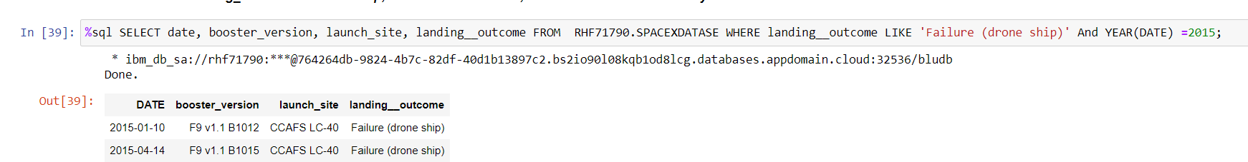
2015 Launch Records
The failed landing outcomes in drone ship in 2015

Slide 34
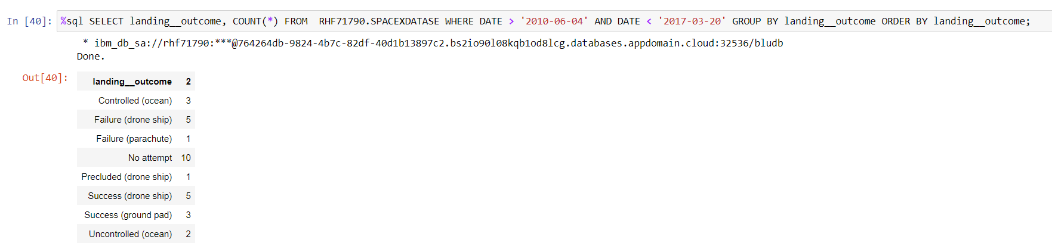
Rank Landing Outcomes Between 2010-06-04 and 2017-03-20
Rank the count of landing outcomes (such as Failure (drone ship) or Success (ground pad)) between the date 2010-06-04 and 2017-03-20

Slide 35

Section 3

Slide 36

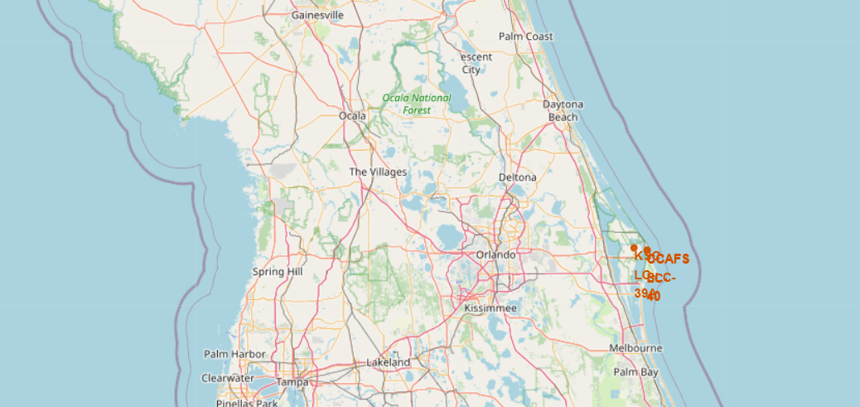
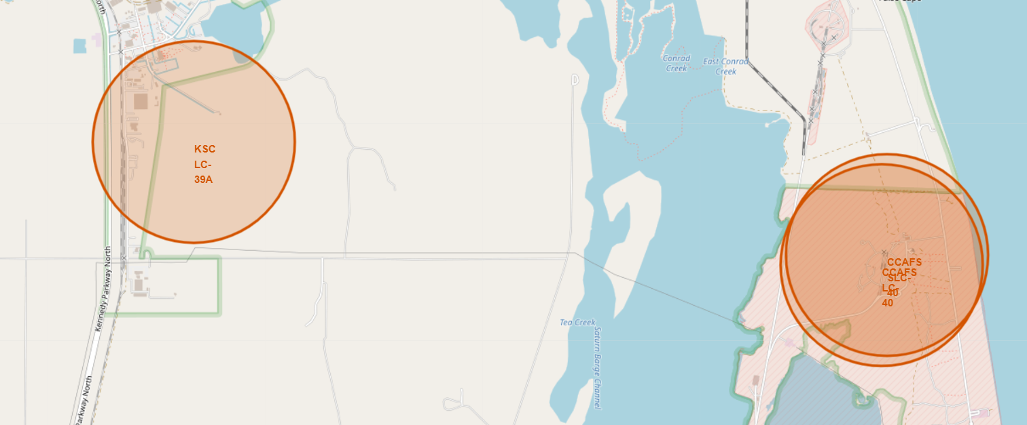
Location of launch sites
All launch sites are located at coastline

Slide 37
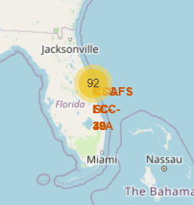
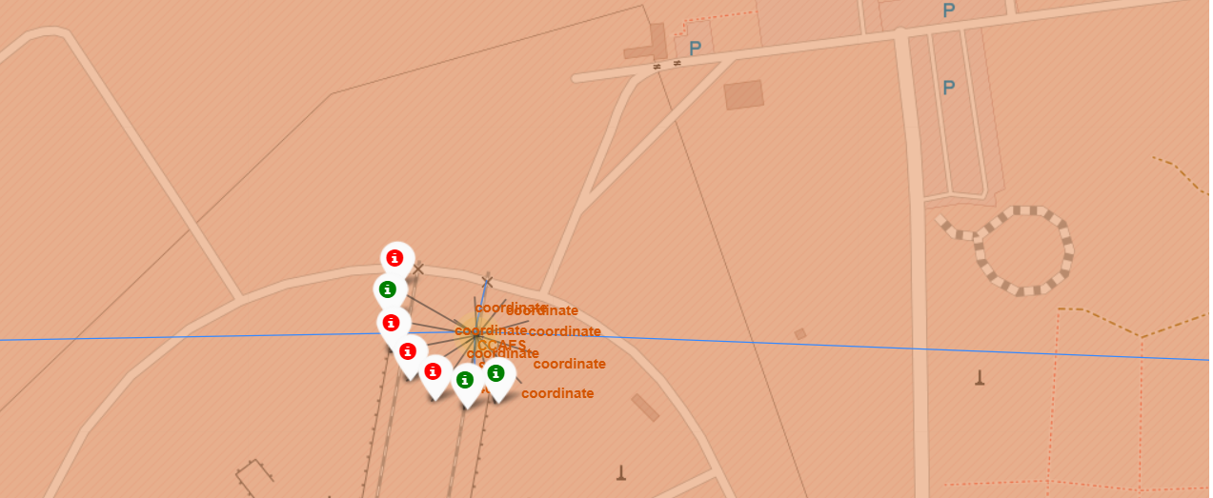
Folium Map – landing outcomes
Florida – on the right screen shoot we see: 3 successful outcomes and 4 unsuccessful

Slide 38
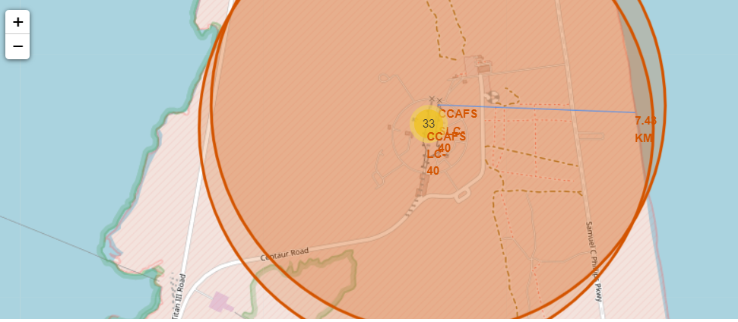
Folium Map – distance to coastline

Slide 39

Section 4

Slide 40
Successful lunches –all sites
KSC LC-39A is the site with the highest number of successful launches ~42%

Slide 41
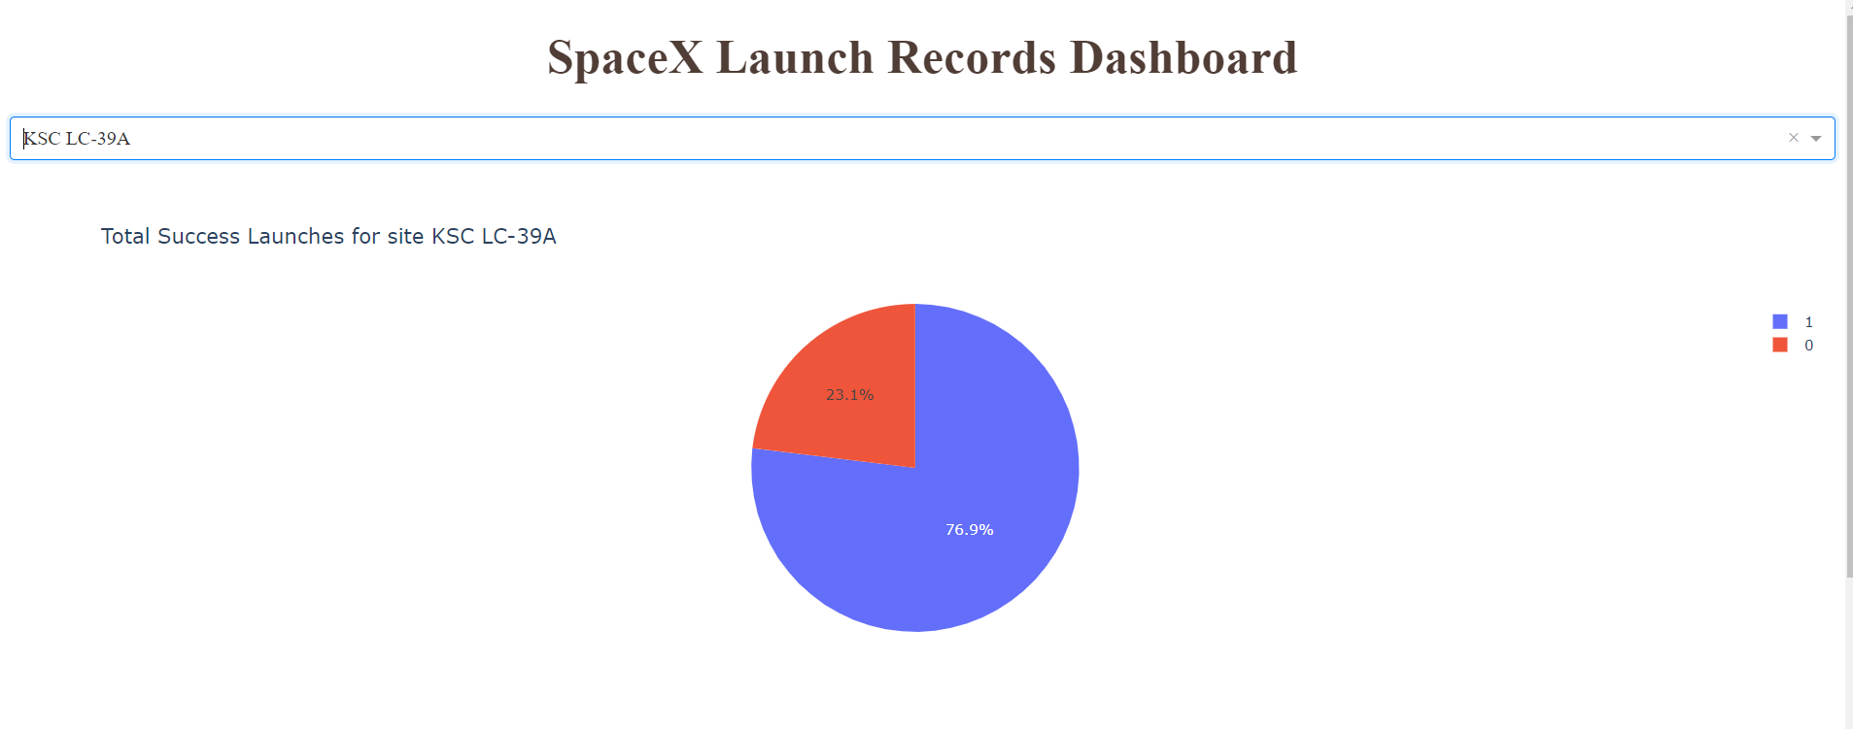
KSC LC-39A – site with highest success ratio
~77% of launches at KSC LC-39A was complited successfuly.

Slide 42
Payload impact on successful launches
Payload mass over 5500kg has negative impact on successful launches, any completed successfully.
In payload range between 2500 – 5500 kg, the biggest number of successful launches was for FT booster.

Slide 43

Section 5

Slide 44
Classification Accuracy
Models SVM, Tree and knn have same accuracy, equal 0.78
Model lr (logistic regression) has the worse accuracy 0.72
All models have quite high accuracy

Slide 45
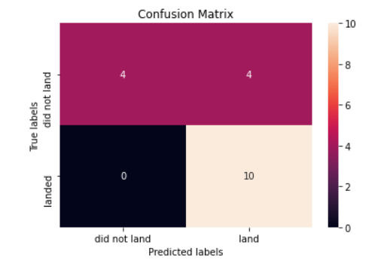
Confusion Matrix
Knn - confusion matrix,
All unsuccessfull landing (4) was predicted correctly,
4 successfull landing was predicted wronlgy,
10 successfull landings was predicted correctly

Slide 46
Conclusions
The purpose of this project was to predict if the Stage 1 of the Falcon rocket land successfully or unsuccessfully,
These information are required by Space Y (competitor of Sapce X) that want to send rocket cheaper than Space X,
Launches data was received from Wikipedia and API of Space X
Models build in this project are able to predict outcome of landings with accurance about 0.78

Slide 47
Appendix
Git hub:
https://github.com/monas1975/IBM_data_science_spaceX_project
IBM data science coure by Coursera:
https://www.coursera.org/professional-certificates/ibm-data-science

Slide 48


